Slide 1
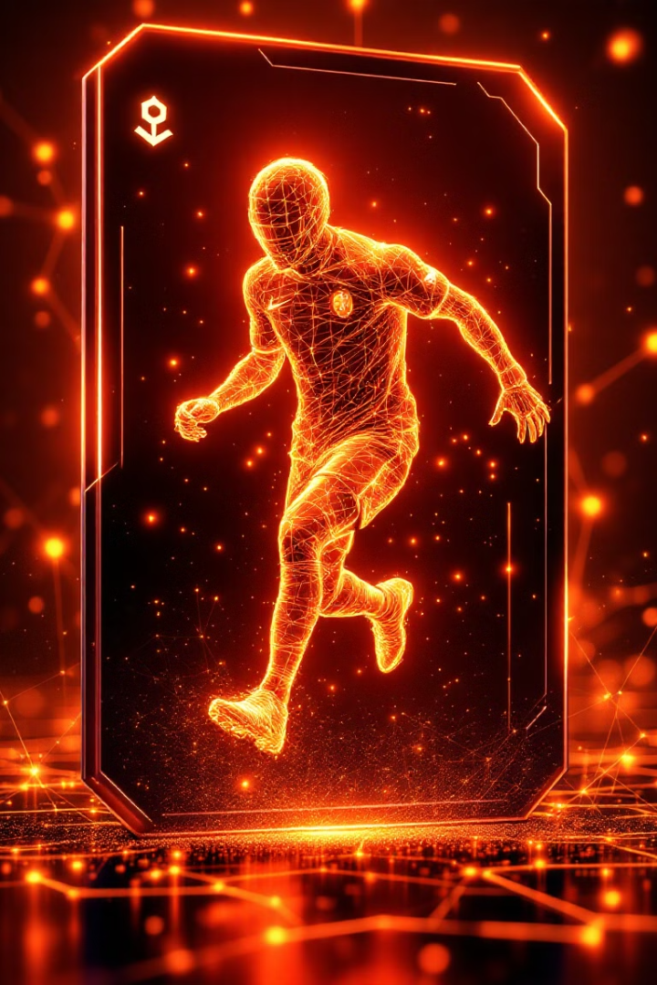

DynamiX Football Player NFTs on Polygon
Introducing our hackathon project: DynamiX NFTs for football enthusiasts. Mint unique, evolving player cards on the Polygon testnet. Experience the thrill of owning digital assets that update in real-time with player stats.

Slide 2
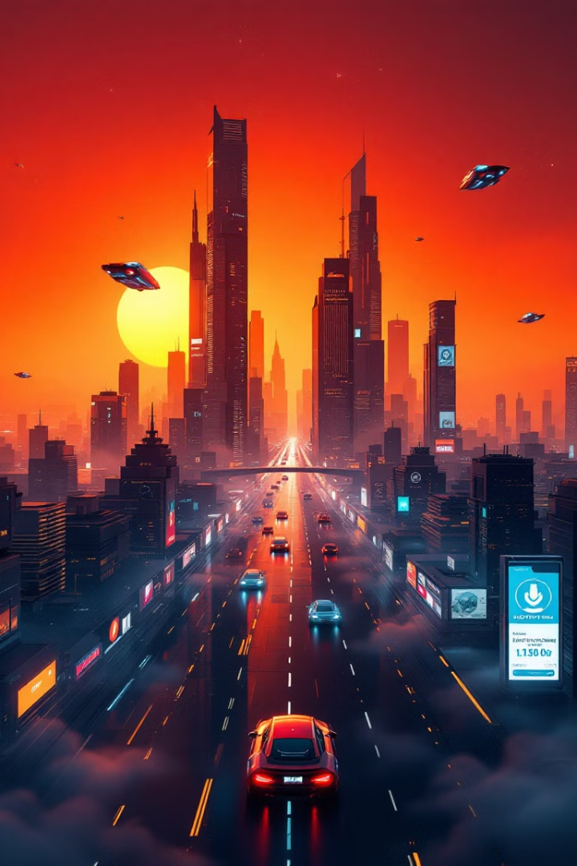
Understanding Dynamic NFTs
Self-Updating
Smart Contracts
Dynamic NFTs automatically refresh their metadata, reflecting real-world changes. They evolve based on external data inputs, creating a living digital asset.
Powered by advanced smart contracts, these NFTs can modify their appearance, attributes, or value. They respond to predefined triggers or oracle-provided information.
Enhanced Utility
Dynamic NFTs offer increased functionality compared to static NFTs. They provide ongoing value and engagement through their ability to change over time.

Slide 3
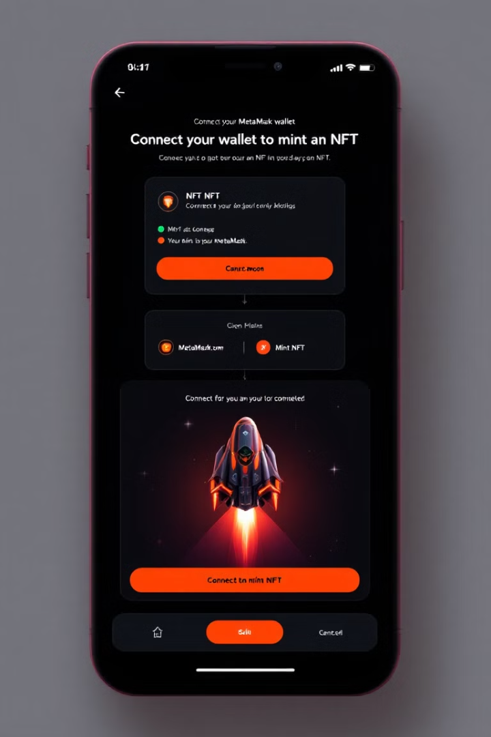
Minting and Managing Your NFTs
1
Connect MetaMask
Link your MetaMask wallet to our platform. Ensure you're on the Polygon testnet for seamless integration.
2
Mint Your NFT
Choose your favorite player and mint a unique Dynamic NFT. The process is quick and gas-efficient on Polygon.
3
Store and Monitor
Your NFT is safely stored in your wallet. Watch as it updates daily with fresh player statistics.

Slide 4
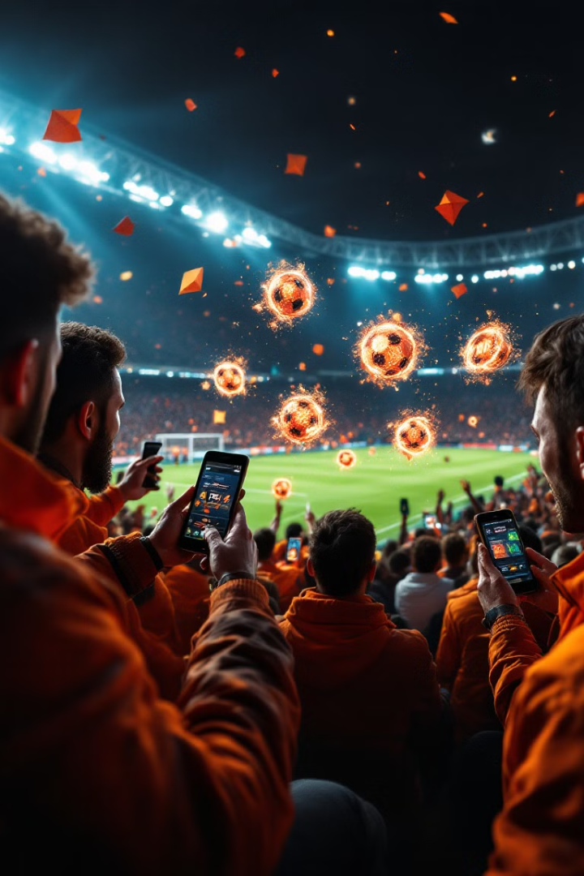
Enhanced Fan Engagement
1
Living Digital Assets
2
Personalized Connection
NFTs evolve with real-world player performance, creating a dynamic collecting experience.
Fans feel closer to their favorite players through these interactive digital representations.

Slide 5
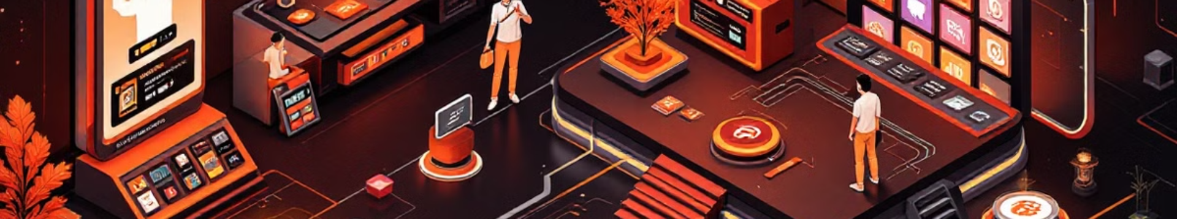




User Journey
Connect MetaMask
Mint Player NFT
Daily Updates
Metaverse Showcase
Users securely link their blockchain wallet to our platform.
Fans choose and mint their desired player's dynamic NFT.
NFTs automatically refresh with the latest player statistics and achievements.
Collectors display their prized NFTs in the Chaarmi metaverse gallery.

Slide 6
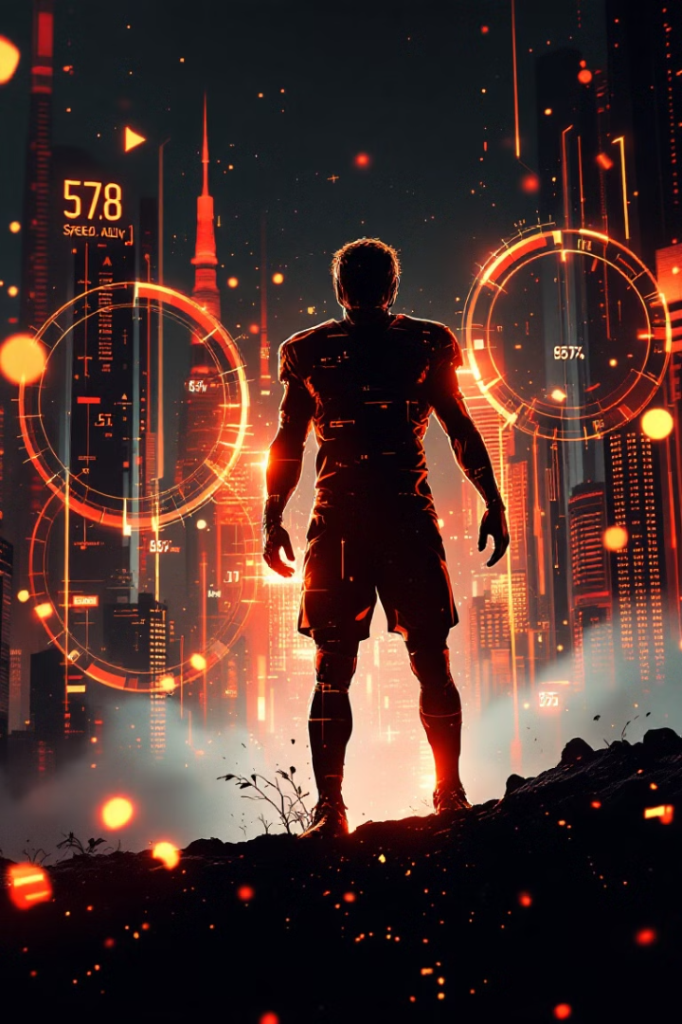



The Power of Dynamic Player NFTs
Daily Updates
NFTs refresh automatically with the latest player data. Stay current with your favorite athletes' performances.
Enhanced Engagement
Experience a new level of connection to players. Your NFT evolves with their real-world achievements.
Unique Collections
Build a dynamic, one-of-a-kind NFT portfolio. Each piece is as unique as the player it represents.

Slide 7
Showcase in the Chaarmi Metaverse
Exclusive NFT Gallery
Interactive Experience
Cross-Platform Integration
Display your prized Dynamic NFTs in our dedicated Chaarmi metaverse gallery. Showcase your collection to other enthusiasts in a cutting-edge virtual environment.
Walk through the gallery and interact with NFTs. View real-time stats and animations. Connect with fellow collectors and share your passion for football.
Seamlessly connect your wallet to the Chaarmi metaverse. Your NFTs automatically appear in your personal gallery space, ready for display.

Slide 8
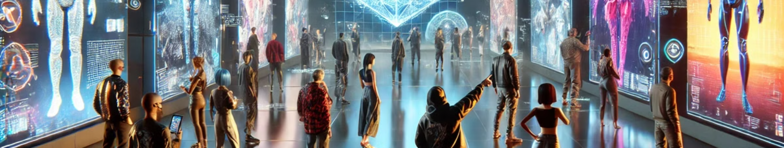
Competitive Edge
Feature
Traditional Collectibles
Our Dynamic NFTs
Real-time Updates
No
Yes
Blockchain Security
No
Yes
Metaverse Integration
No
Yes
Interactive Elements
Limited
Extensive

Slide 9
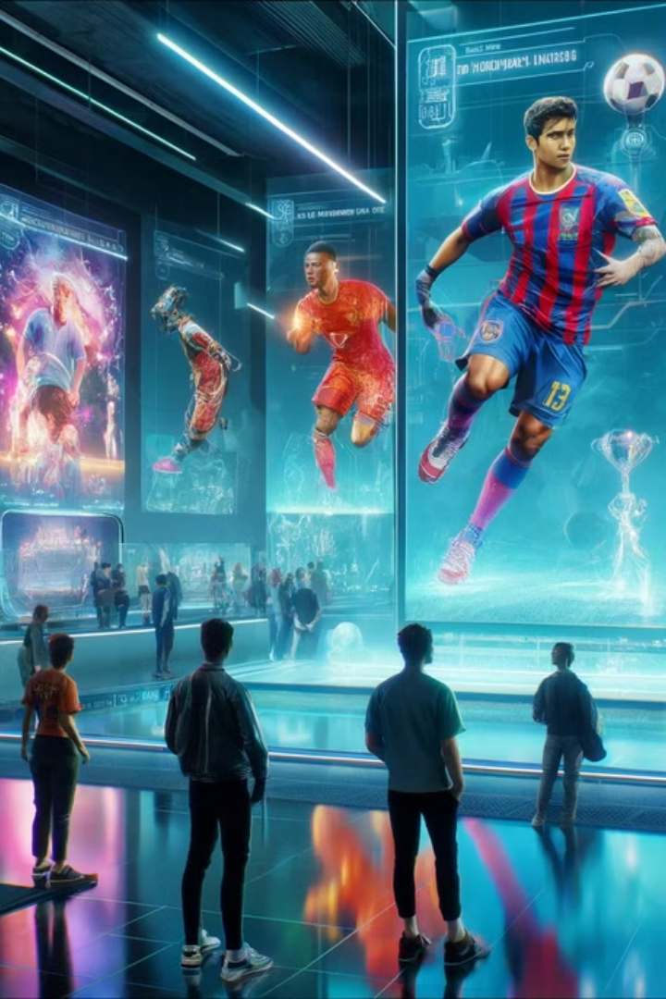



Why Chaarmi Metaverse?
Quick Setup
Effortlessly integrate your NFTs into the Chaarmi metaverse within minutes.
Cost-Effective
Affordable entry and maintenance costs for both creators and collectors.
Seamless Marketplace
Easy linking of NFTs to buy/sell platforms, enhancing liquidity and value.

